Slide 1
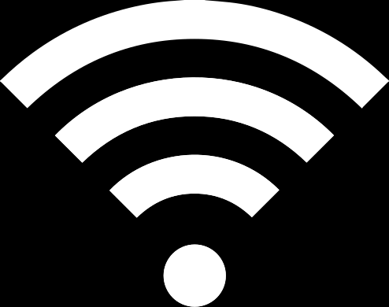
Computer Networks
COMPUTER NETWORKS
Piyush Narula (2022354) Aditya Aggrawal (2022028)

Slide 2
"IMPLEMENTATION OF GO-BACK-N PROTOCOL SIMULATION"
Understanding the Go-Back-N Protocol
it is a protocol in the Data Link Layer for reliable data transmission.
Unlike protocols that immediately retransmit lost or corrupted packets one-by-one, Go-Back-N employs a more efficient approach by sending multiple frames before requiring an acknowledgment (ACK) from the receiver.

Slide 3
ASSIGNMENT REQUIREMENTS
1. Random Packet Generation: Packets (or frames) should be generated at random intervals, simulating a real-world scenario where data doesn’t always arrive at a fixed pace.
2. Sliding Window Mechanism: In the Go-Back-N protocol, the sliding window mechanism allows the sender to transmit multiple frames without waiting for an acknowledgment of each one.
The sequence numbers will wrap around after a maximum value, following a modulo operation, specifically modulo-8 (meaning sequence numbers range from 0 to 7).
3. Drop Probability and Delay: To simulate real network conditions, there should be a specified probability that a frame will be dropped.
4. Client-Server Simulation: The assignment uses datagram (UDP) sockets to create a client-server model where two separate entities communicate, simulating the data link layer’s two endpoints.

Slide 4
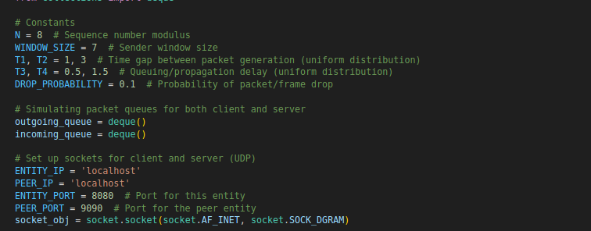
CONSTRAINTS
N = 8 (Sequence Number Modulus): Defines the modulus for sequence numbers used in the protocol. Since Go-Back-N uses sequence numbers to keep track of packets
WINDOW_SIZE = 7 (Sender Window Size): Sets the maximum number of unacknowledged packets that the sender can transmit before waiting for acknowledgment.
T1, T2 = 1, 3 (Time Gap Between Packet Generation): Defines the random time interval between the generation of packets, simulating non-uniform packet creation.
T3, T4 = 0.5, 1.5 (Queuing/Propagation Delay): Sets the random delay range representing network queuing and propagation delays.
DROP_PROBABILITY = 0.1 (Probability of Packet/Frame Drop): Establishes a 10% chance of packet loss during transmission, simulating unreliable network conditions.

Slide 5
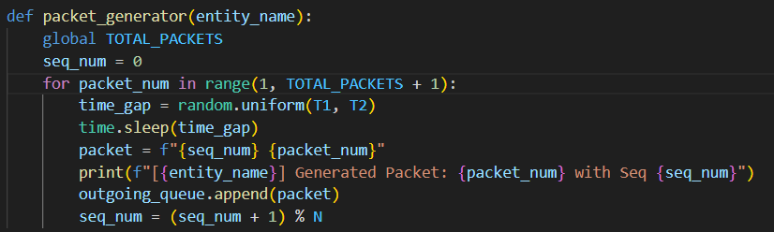
PACKET GENERATION PROCESS
Random Time Interval (time_gap): The random.uniform(T1, T2) function generates a random delay between T1 and T2 seconds. This delay is used to wait before creating the next packet, simulating a fluctuating packet generation rate.
Packet Creation: Each packet is created with a sequence number (seq_num) and an identifier for the entity generating it, such as "Sender Packet 0".
Outgoing Queue: Each packet is appended to an outgoing_queue, which represents packets ready to be sent. This queue simulates packets waiting in line for transmission in a network buffer.
Outgoing Queue: Each packet is appended to an outgoing_queue, which represents packets ready to be sent. This queue simulates packets waiting in line for transmission in a network buffer.

Slide 6
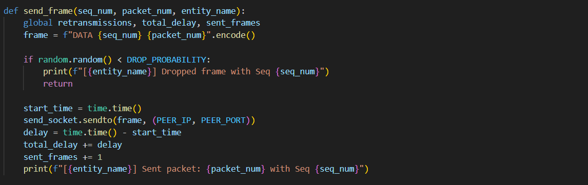
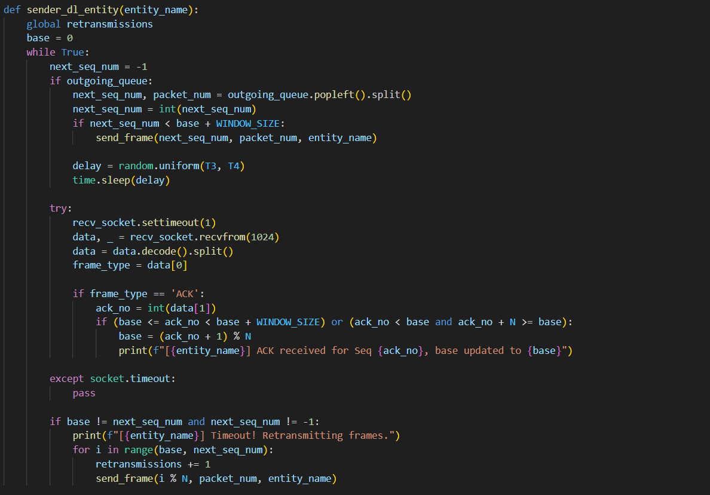
FRAME SENDER
send_frame Function: This function is responsible for sending frames with a simulated packet loss. Using a random probability, it determines if a frame should be "dropped" (not sent), simulating an unreliable network.
sender_dl_entity Function: Implements Go-Back-N protocol’s sender logic. Window and Base Handling: Tracks the base of the sliding window and the next sequence number to send, ensuring that only frames within the window size (WINDOW_SIZE) are sent.

Slide 7
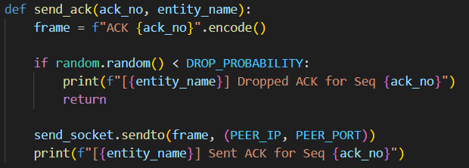
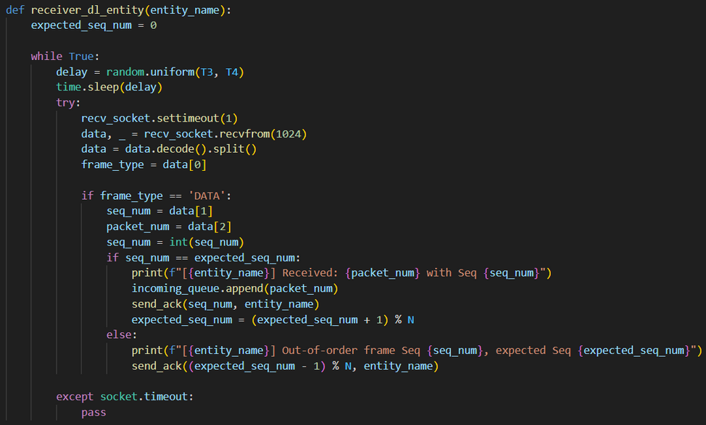
FRAME RECEIVER
send_ack Function: This function simulates the sending of an acknowledgment (ACK) back to the sender. It creates an ACK frame with a sequence number (ack_no) indicating the last correctly received frame.
Packet Loss Simulation: Similar to data frames, ACKs may be "dropped" based on a random probability (DROP_PROBABILITY). If the ACK is dropped, the function logs this event and does not send the ACK, simulating a potential network loss.
Role of ACKs in Go-Back-N Protocol: ACKs inform the sender about the successful receipt of packets. In Go-Back-N, if ACKs are dropped, the sender doesn’t receive confirmation and will eventually retransmit the unacknowledged frames, ensuring that all data is eventually received reliably, despite potential losses.

Slide 8
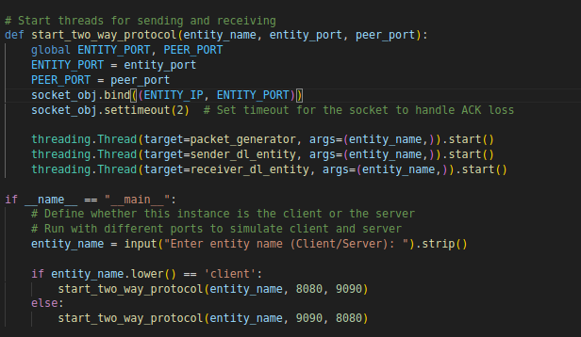
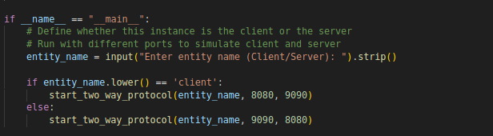
START_TWO_WAY_PROTOCOL:
This code sets up a two-way Go-Back-N protocol simulation between a "Client" and a "Server" over UDP. The start_two_way_protocol function initializes the entity's port, binds a socket, and starts three threads: one for generating packets, one for sending packets, and one for receiving packets and handling ACKs. The main program determines whether the instance acts as a Client or Server based on user input, setting the appropriate communication ports for each.

Slide 9
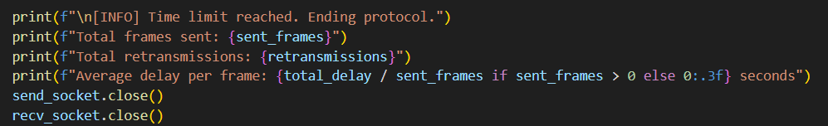

THREADING AND STATISTICS
Threads: 3 threads are used: one for continuous packet generation, one for carrying the functions of the frame sender, and the last one for functions associated with the frame receiver of the data link layer
Required statistics like the number of frames sent, retransmissions (due to the probability of certain frames being dropped) and average delay are calculated as shown above to determine performance.

